Slide 1
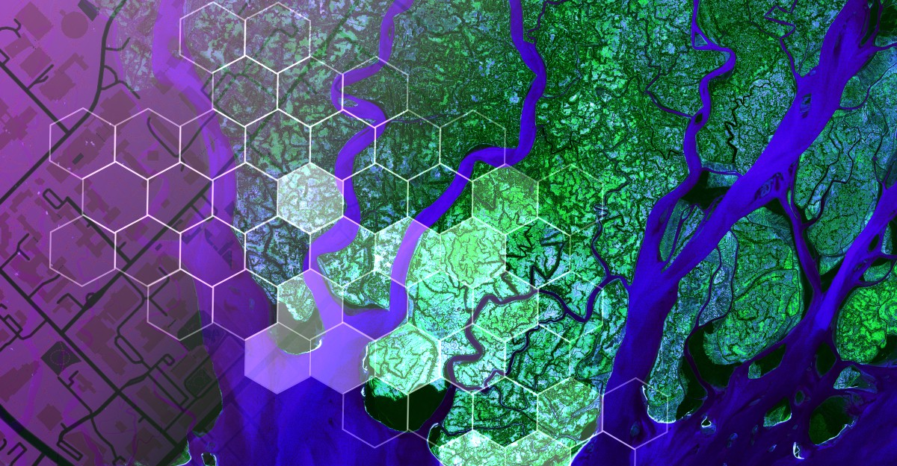

Proxima Centaury b‘s habitability zone
PIRES Mathéo
1

Slide 2
Summary
Introduction
Flowchart
Implementation
Demonstration
PIRES Mathéo
2

Slide 3
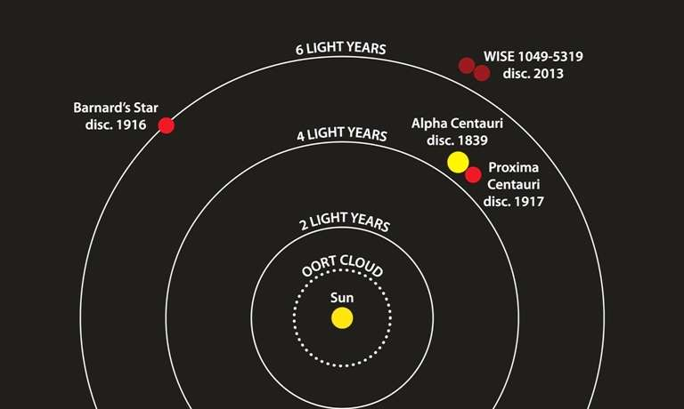
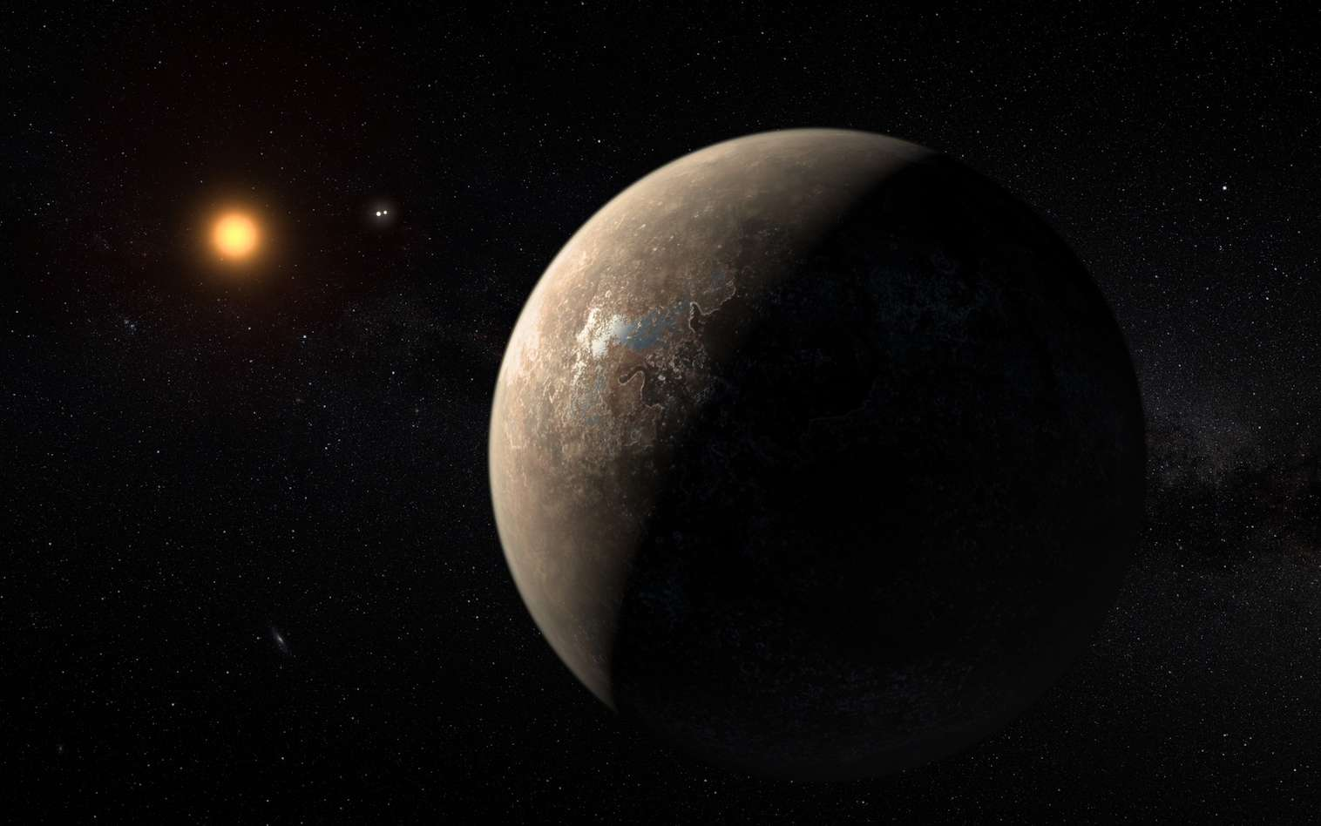
Introduction
Goal
Why
The planet does 3 rotations on itself at each revolution of his star
PIRES Mathéo
3

Slide 4
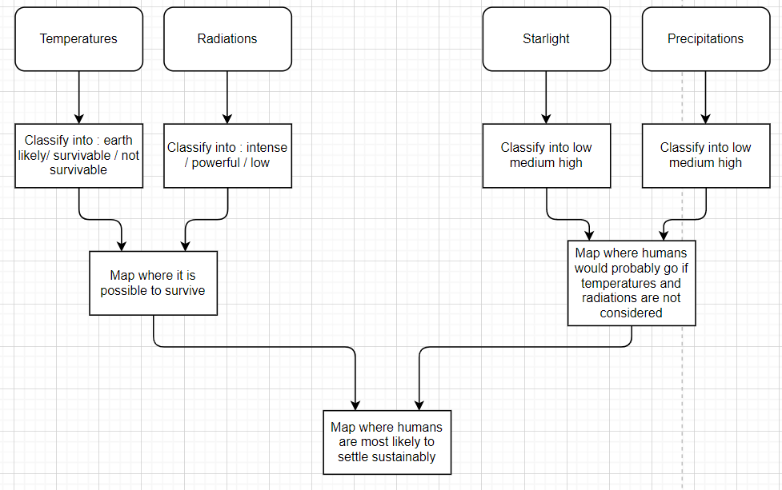
Flowchart
PIRES Mathéo
4

Slide 5
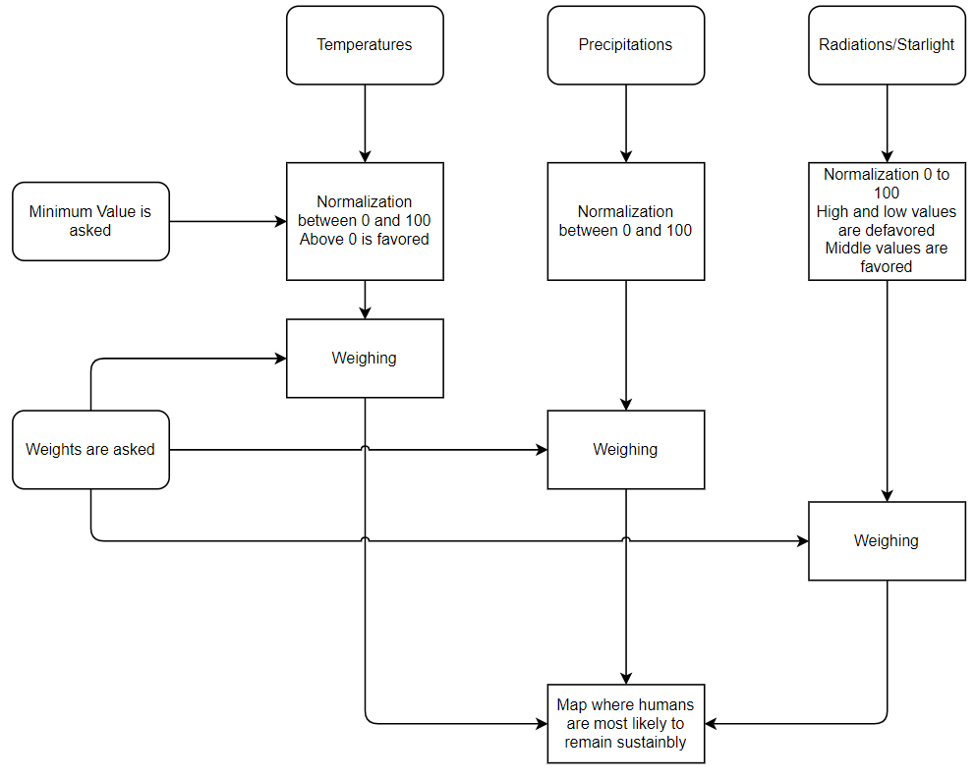
Flowchart
PIRES Mathéo
5

Slide 6
Implémentation
Precipitations
Temperatures
Solar radiation
PIRES Mathéo
6

Slide 7
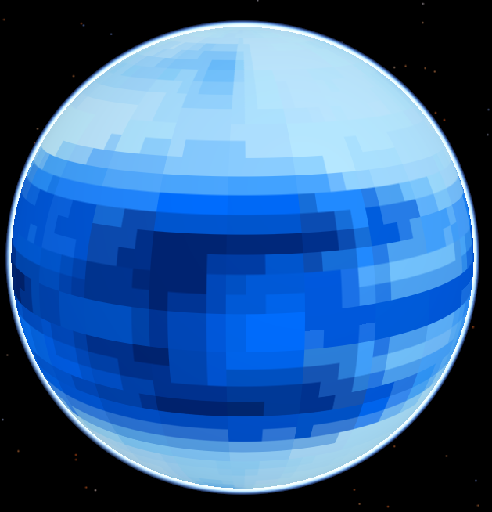
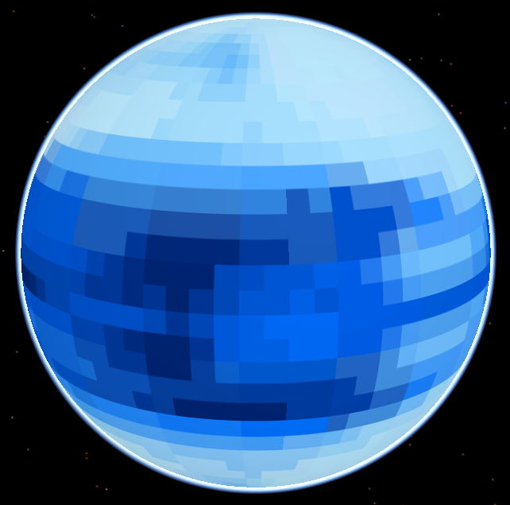
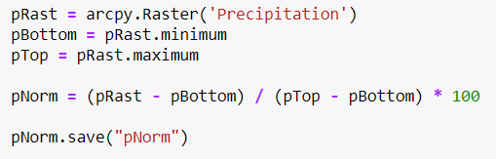


Precipitations
PIRES Mathéo
7

Slide 8
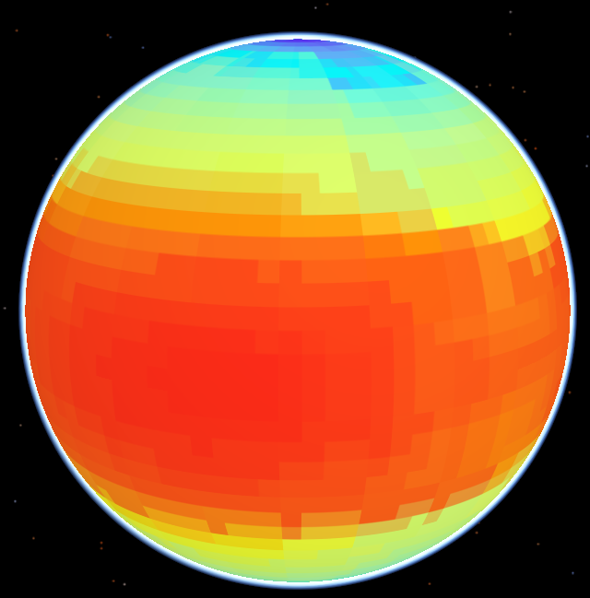
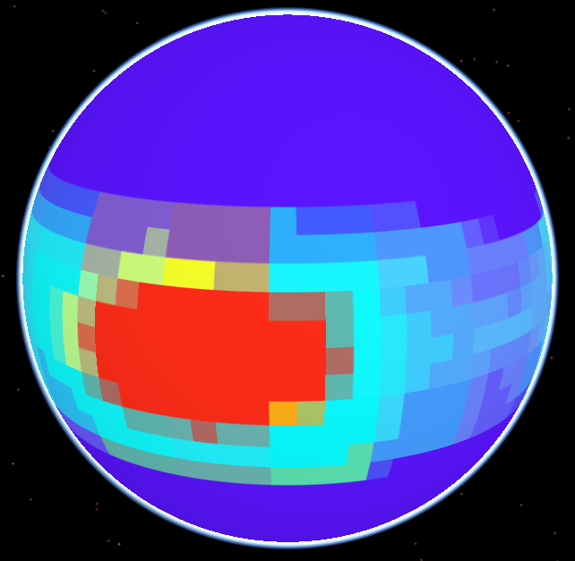
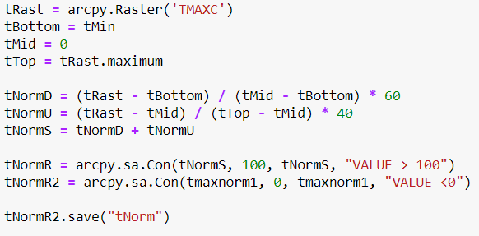


Temperatures
PIRES Mathéo
8

Slide 9
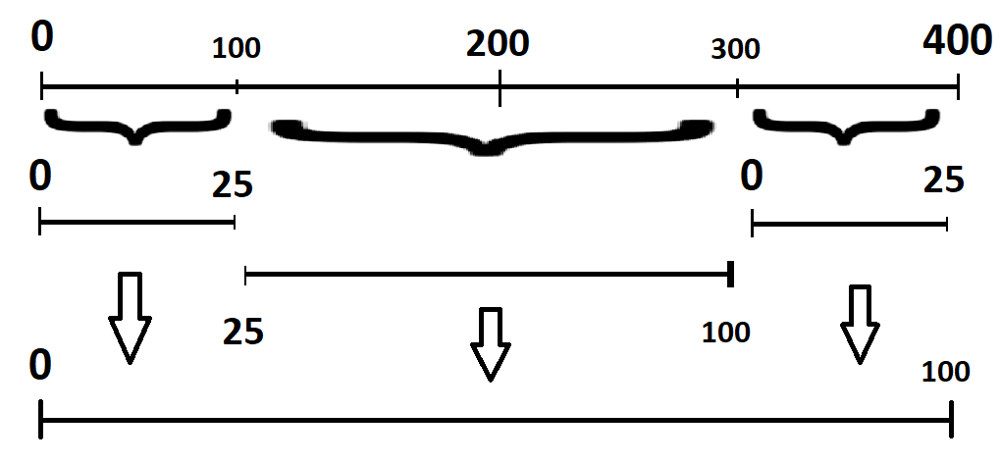
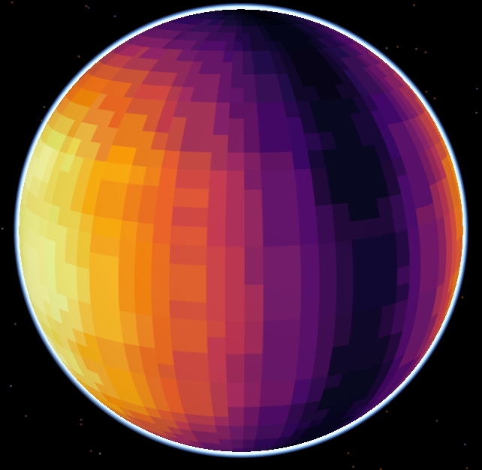
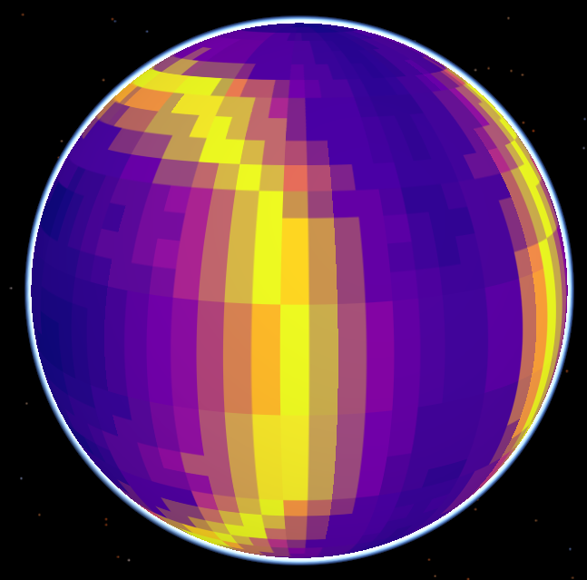
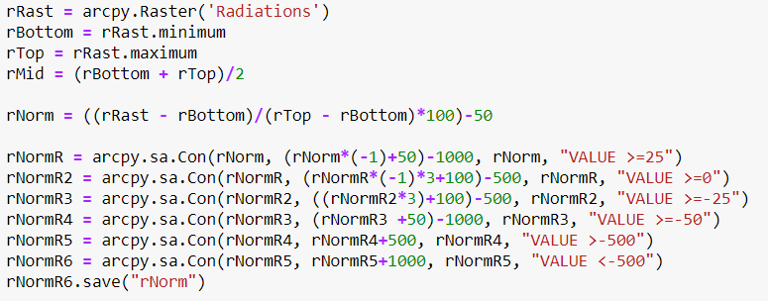


Radiations
PIRES Mathéo
9

Slide 10
Demonstration
PIRES Mathéo
10

Slide 11
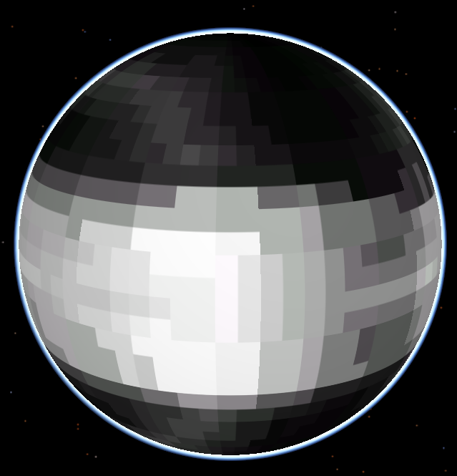
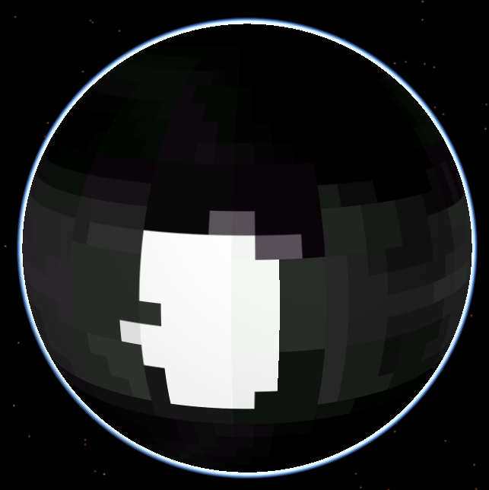
Precipitations : 0.2
Temperature : 0.5
Radiations : 0.3
PIRES Mathéo
11

Slide 12
Thanks for your attention
PIRES Mathéo
12

